Slide 1
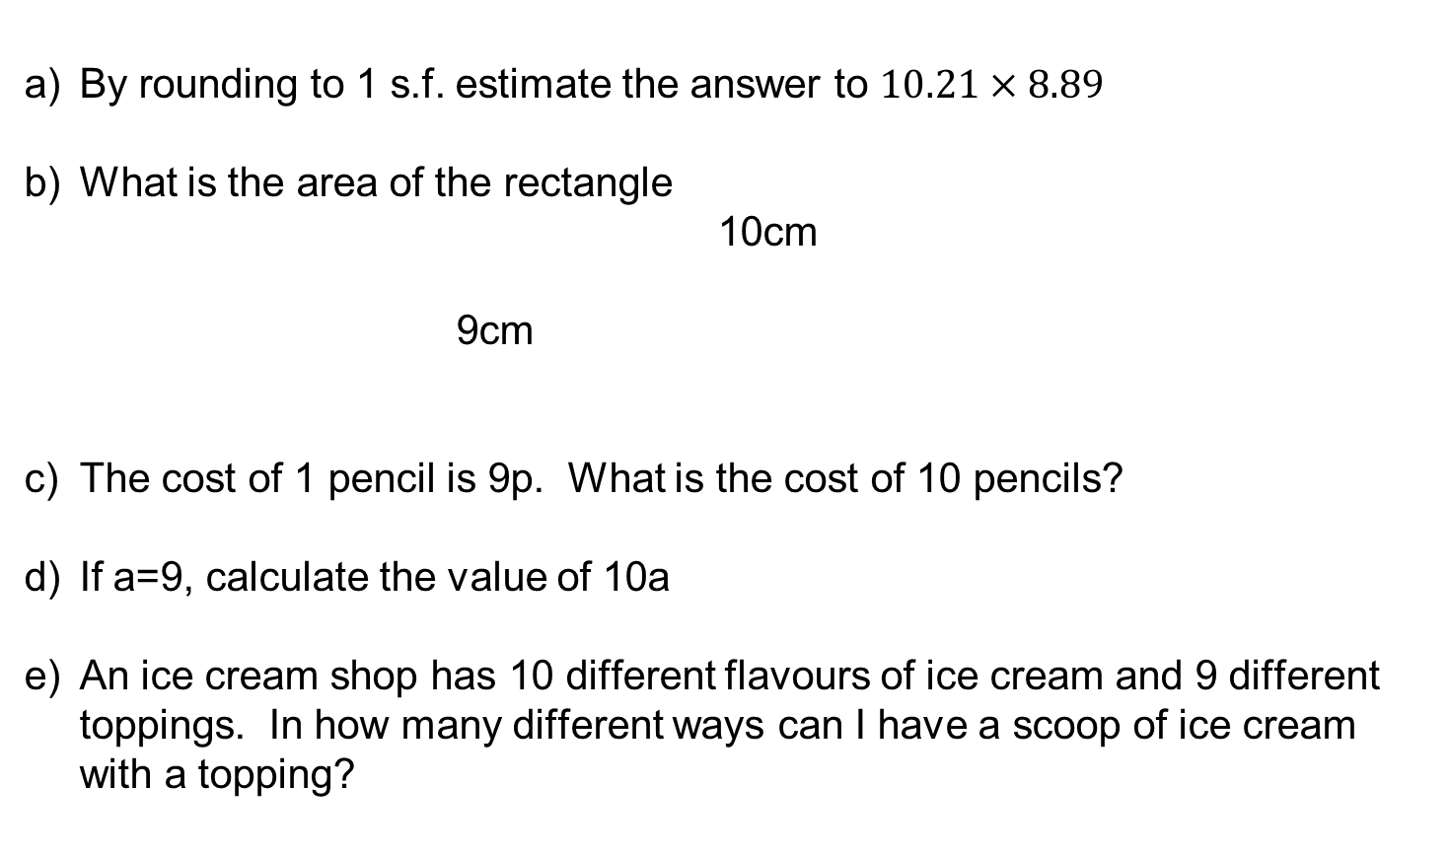
Solve these
Reflect: how did you know what to do?
By rounding to 1 s.f. estimate the answer to $10.21×8.89$
What is the area of the rectangle
10cm
9cm
The cost of 1 pencil is 9p. What is the cost of 10 pencils?
If a=9, calculate the value of 10a
An ice cream shop has 10 different flavours of ice cream and 9 different toppings. In how many different ways can I have a scoop of ice cream with a topping?

Slide 2

Aims
Define what is meant by ‘problem solving’ in the National Curriculum
Go through 2-3 strategies that are specific enough to be teachable but generic enough to be useful

Slide 3

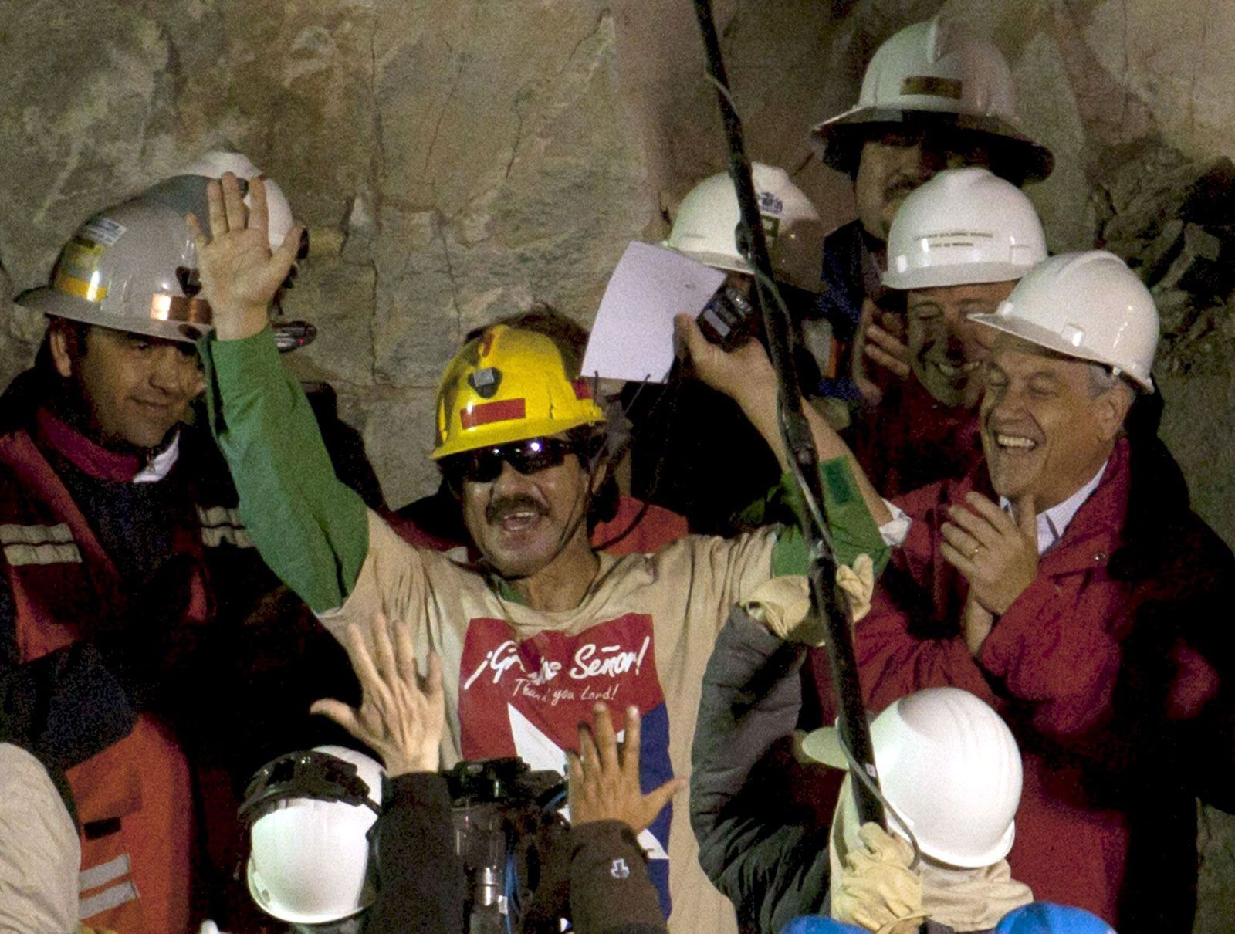
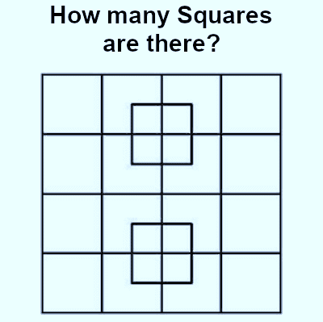
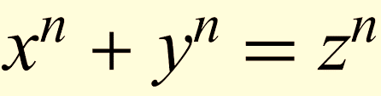

Slide 4
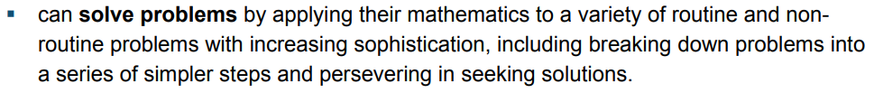
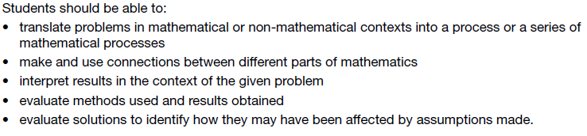



Slide 5
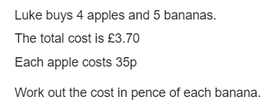
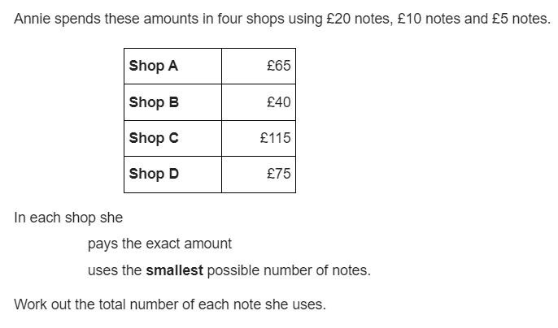
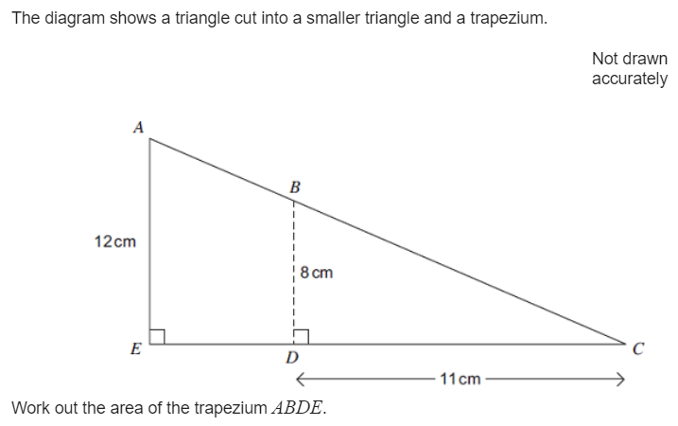
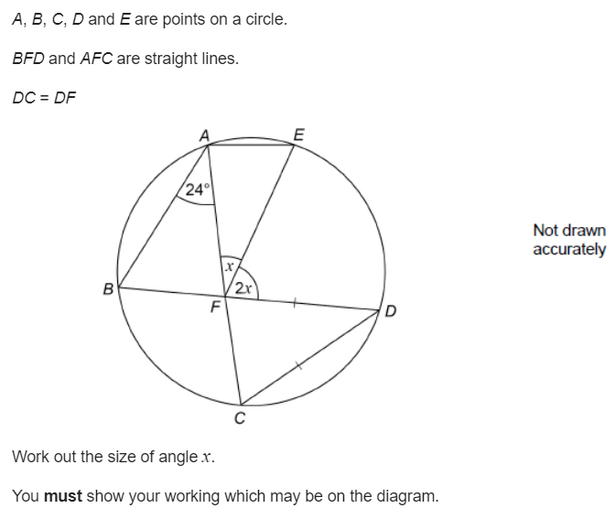

Slide 6
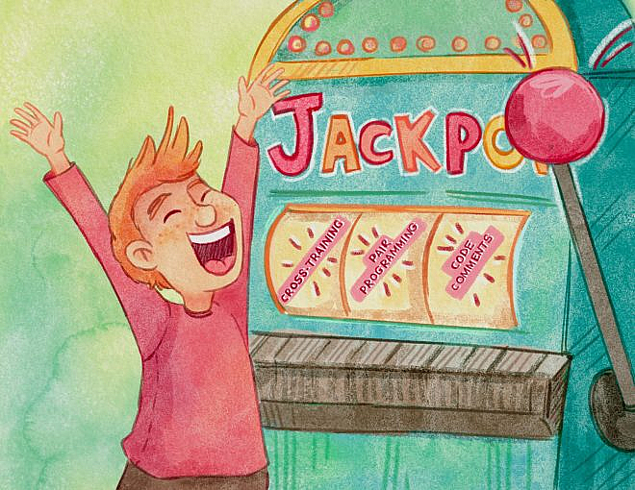

Slide 7
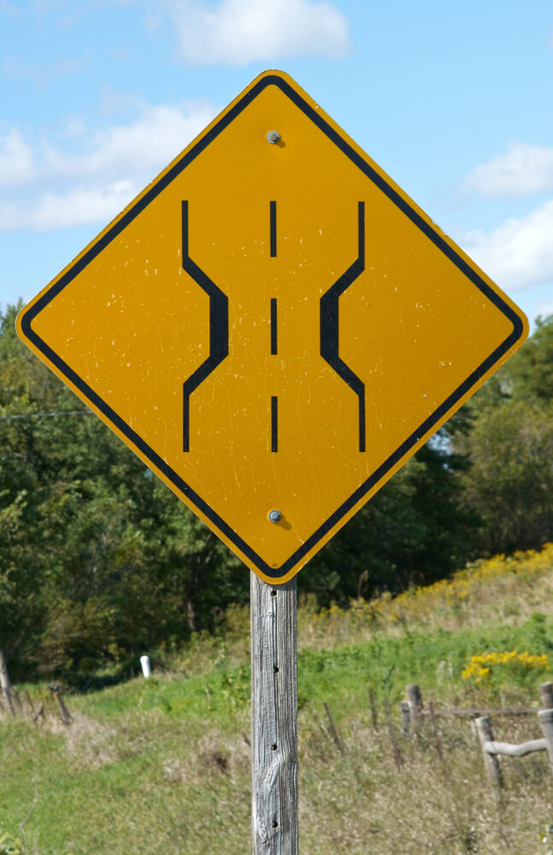

Slide 8
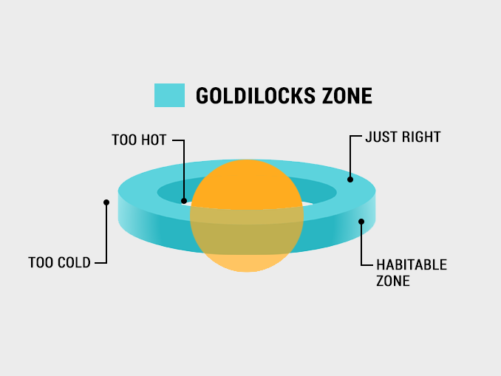
Backwards Plan
Too specific
Just right
So What?!
Goal-Free Problems
Too generic
Useful
strategies
Number-Free Problems
Zoom In – Zoom Out

Slide 9
A Christmas Carol
Gothic Literature
Poetry
…
…
Inference
Comparison

Slide 10
Chemistry
Physics
Biology
Analyse
Experiment

Slide 11
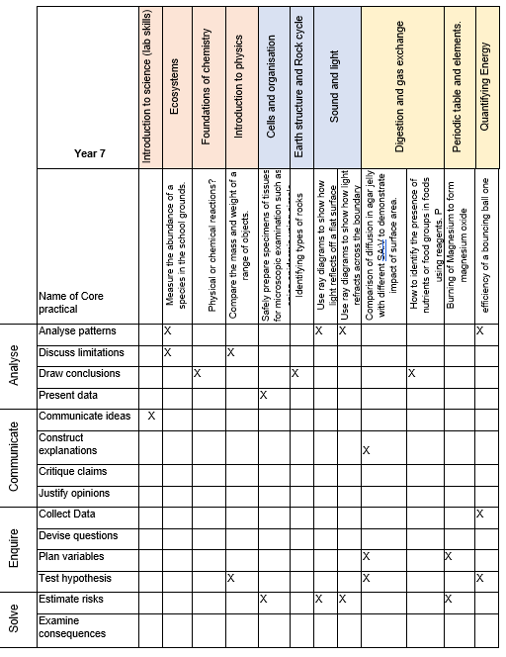

Slide 12
Algebra
Number
Geometry
Probability and Statistics
Proportion
Problem Solving
Communicating
Evaluating
…

Slide 13
Backwards Plan
Too specific
Just right
So What?!
Goal-Free Problems
Too generic
Useful
strategies
Number-Free Problems
Zoom In – Zoom Out

Slide 14
Solve these
Reflect: how did you know what to do?
What is the area of the rectangle
10cm
9cm
The cost of 1 pencil is 9p. What is the cost of 10 pencils?
If a=9, calculate the value of 10a

Slide 15
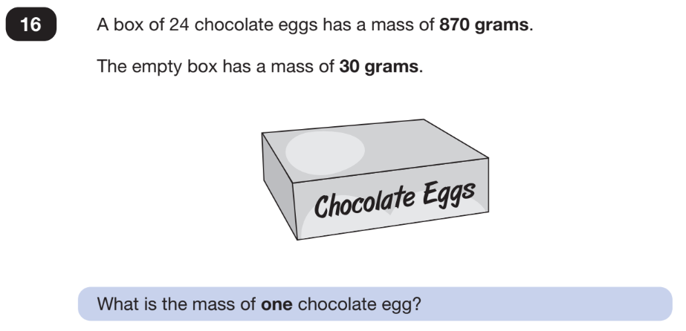
Notes:
15

Slide 16
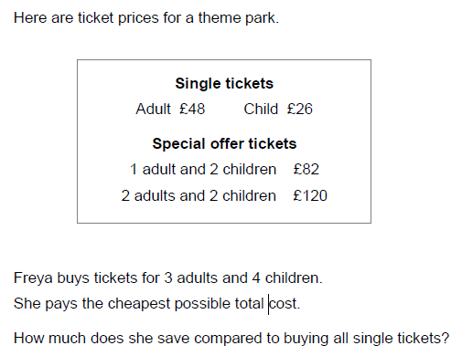
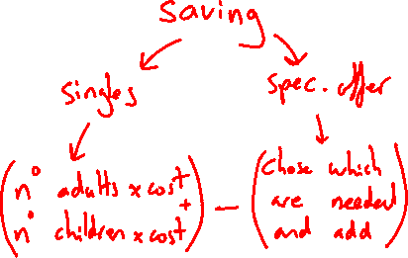
Notes:
16

Slide 17
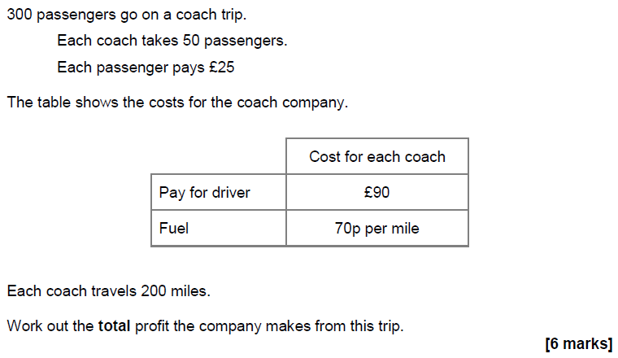
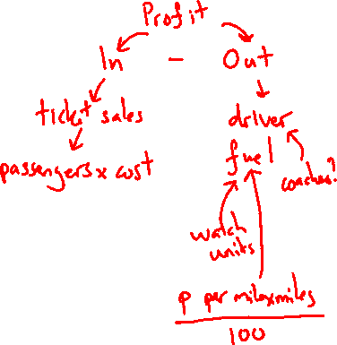
Notes:
17

Slide 18
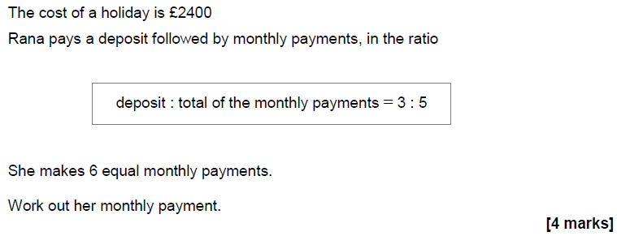
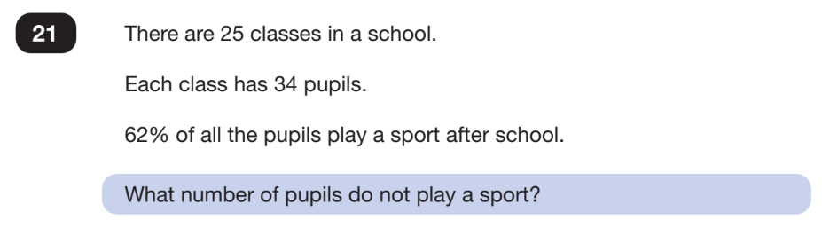
Notes:
18

Slide 19
Notes:
19

Slide 20
Notes:
20

Slide 21
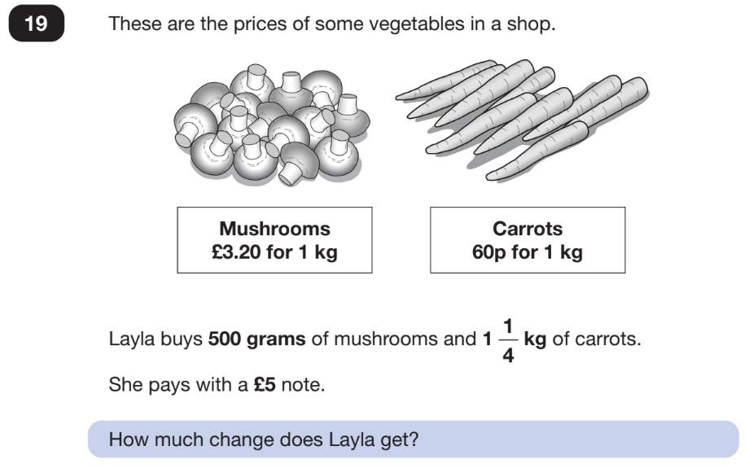
Notes:
21

Slide 22
Reflect
Do you think you ignore the numbers when you solve problems like this naturally?
Does this feel teachable?
Does this feel useful?

Slide 23


Slide 24
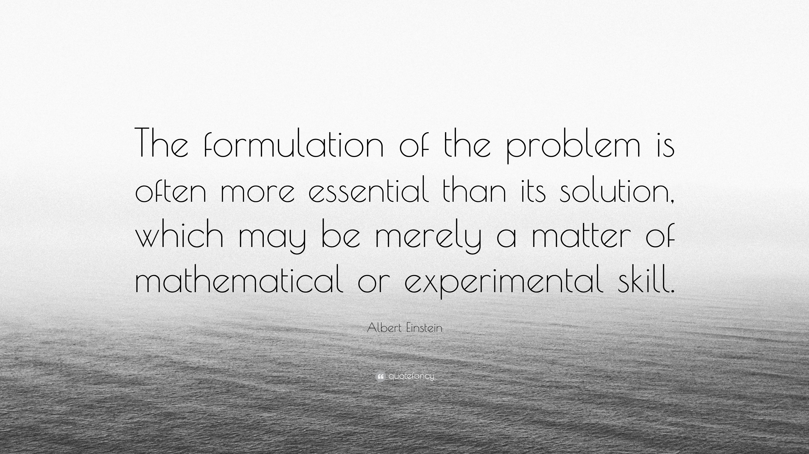

Slide 25
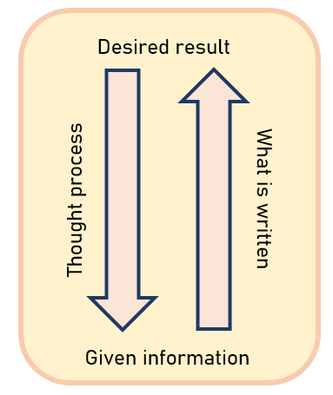

Slide 26
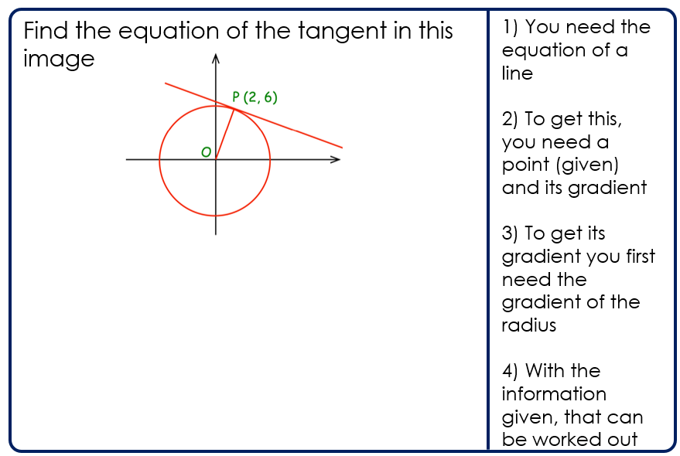
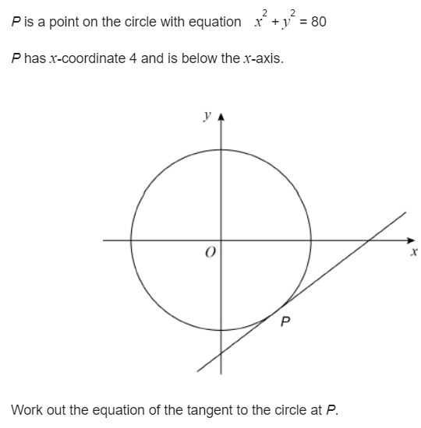

Slide 27
Reflect
Do you think you backwards plan complex questions naturally?
Does this feel teachable?
Does this feel useful?

Slide 28


Slide 29
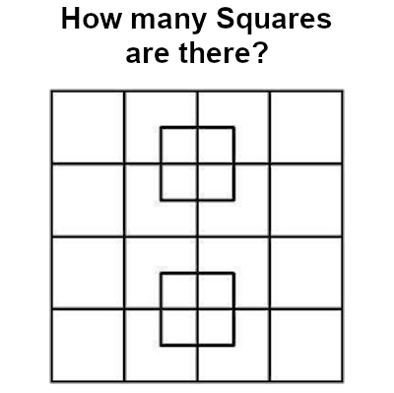

Slide 30
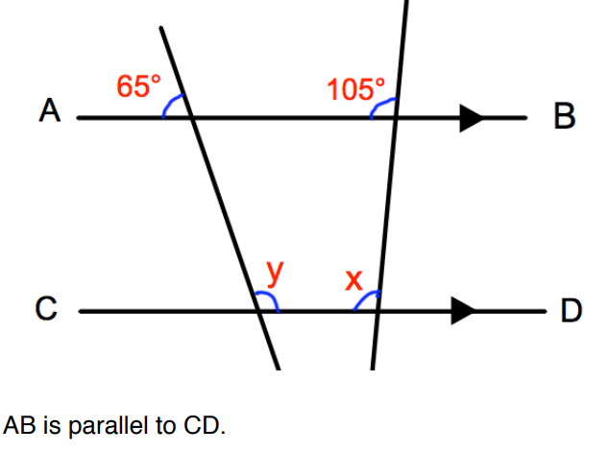

Slide 33
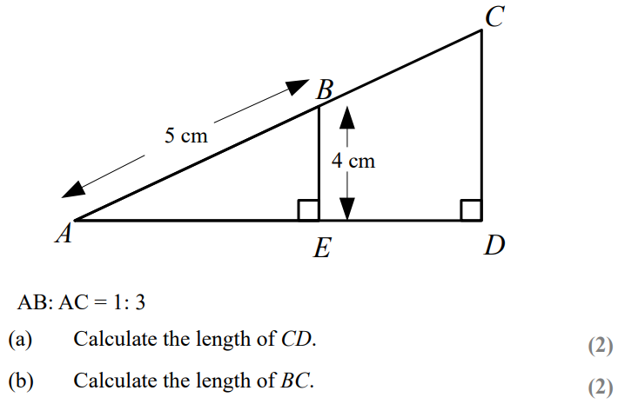


Slide 34
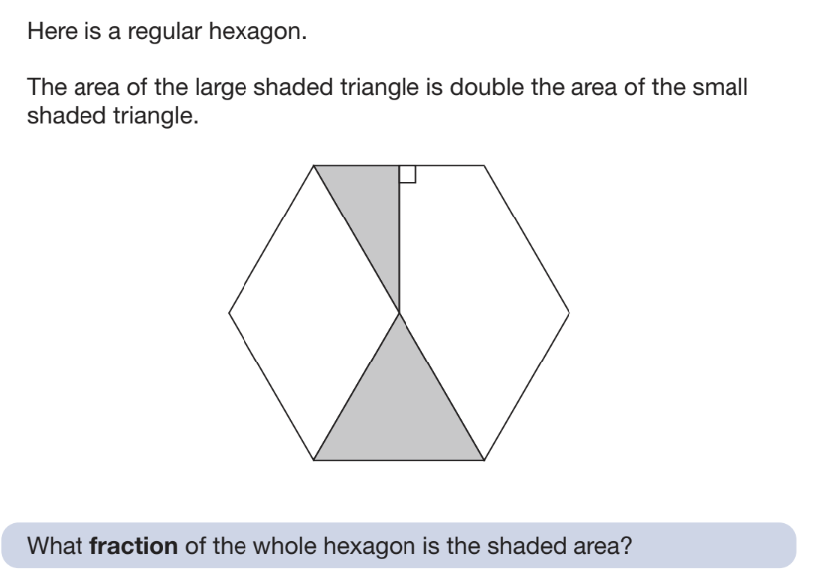

Slide 36
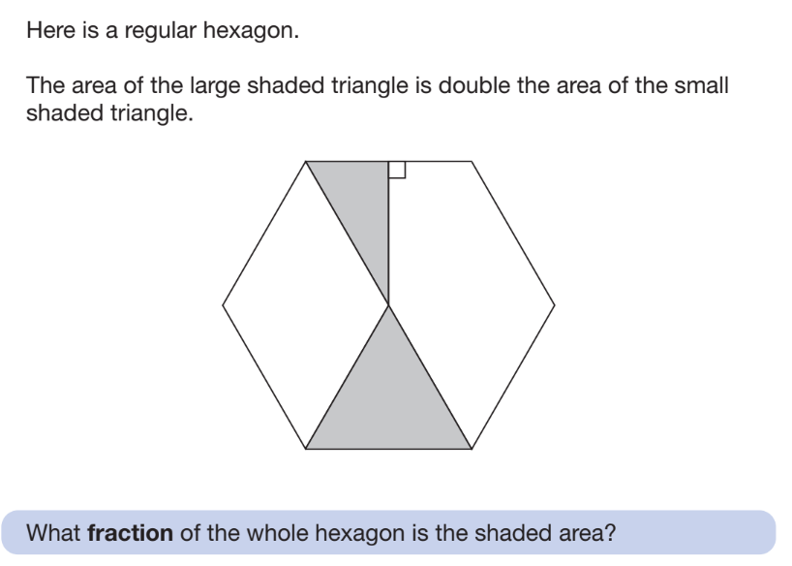

Slide 37
Reflect
Do you think you zoom in and zoom out naturally?
Does it need a better name? Isolate and extrapolate?
Does this feel teachable?
Does this feel useful?

Slide 38
Do you do anything similar?
Do you codify any of the skills you want students to apply?
Do these feel useful?

